Slide 1
REPORT
A REPORT IS A FORMAL DOCUMENT WRITTEN FOR A SPECIFIC AUDIENCE TO MEET A SPECIFIC NEED.

Slide 2
Why report ?
Why report?
Enhanced business value
Improved operations
Strengthened relationships
Enhanced trust and credibility
And a few more …
Meet growing expectations of broad range of stakeholders
Improved reputation with socially responsible investors
Employee recruitment and retention
Brand protection and customer loyalty

Slide 3
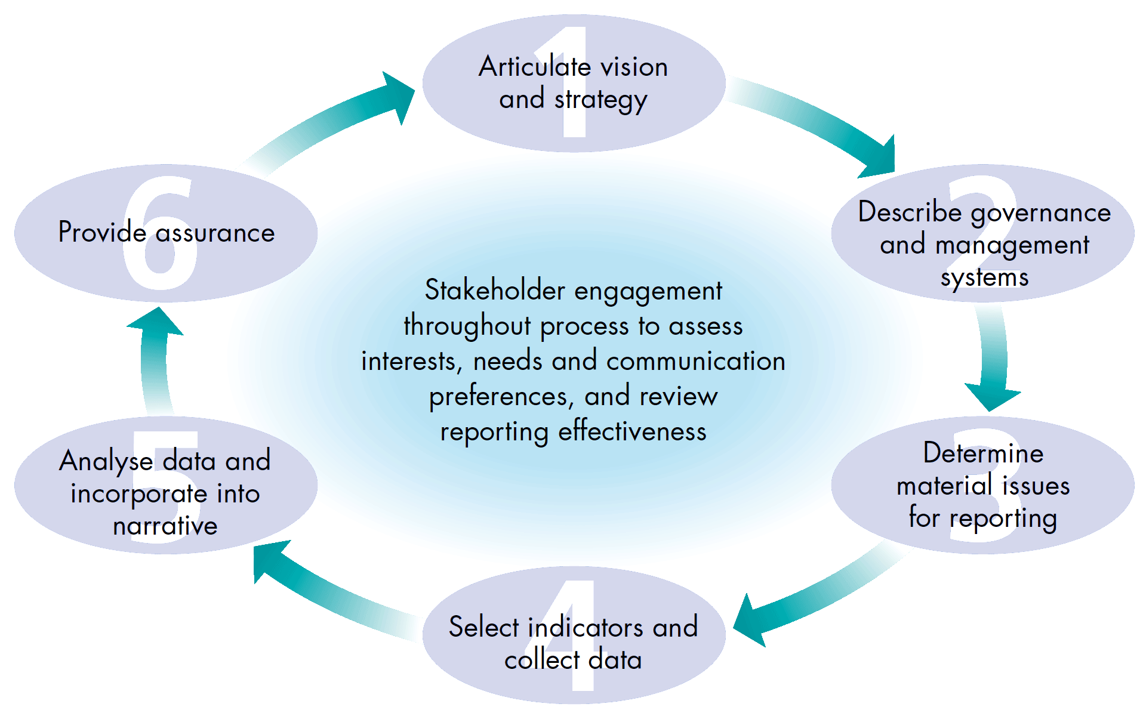
How to report

Slide 4
PURPOSES OF REPORT
PRESENTING DATA
DESCRIBING PROBLEMS AND SUGGESTING SOLUTIONS
DISCUSSING AND ANALYSING DATA
RECORDING EVENTS AND HAPPENINGS
ANALYSING A SITUATION OR A CONDITION
GIVING FEEDBACK, SUGGESTIONS, OR RECOMMENDATIONS

Slide 5
CHARACTERISTICS
PURPOSIVENESS
WELL ORGANISED
PRODUCE SOME RESULTS

Slide 6
STEPS IN REPORT WRITING
COLLECTION OF DATA
PREPARATION AND OBJECTIVE
ORGANISING
CHECKING AND EDITING

Slide 7
STRUCTURE OF REPORT
1. FRONT MATTER
COVER PAGE
TITLE PAGE
COPY RIGHT NOTE
PREFACE
ACKNOWLEDGEMENT
TABLE OF CONTENTS
ILLUSTRATIONS AND TABLES
ABSTRACT AND SUMMARY
INTRODUCTION

Slide 8
MAIN BODY
DESCRIPTION
CONCLUSION
RECOMMENDATIONS

Slide 9
BACK MATTER
APPENDIX
REFERENCES
BIBLIOGRAPHY
GLOSSARY
INDEX

Slide 10
TYPES AND FORMS OF REPORT
LONG AND SHORT REPORTS
FEASIBILITY REPORT
INVESTIGATIVE REPORT
PROGRESS REPORT
AUDIT REPORT
STAFF REPORT
CONFIDENTIAL REPORT
TECHNICAL REPORT
EVALUATION REPORT
NEWS PAPER REPORT
BLANK FORMAT REPORT
LETTER REPORT
MEMORANDUM

Slide 11
FORMAT OF REPORT
NAME OF ORGANISATION/INSTITUTION
TO: REF. :
FROM: DATE:
SUBJECT:
POINTS DISCUSSED/STUDIED/OBSERVED/WORK DONE
------------------------------------------------------------------------
------------------------------------------------------------------------
RECOMMENDATIONS:
---------------------------------------------------------------------------
------------------------------------------------------------------------------

